Slide 1
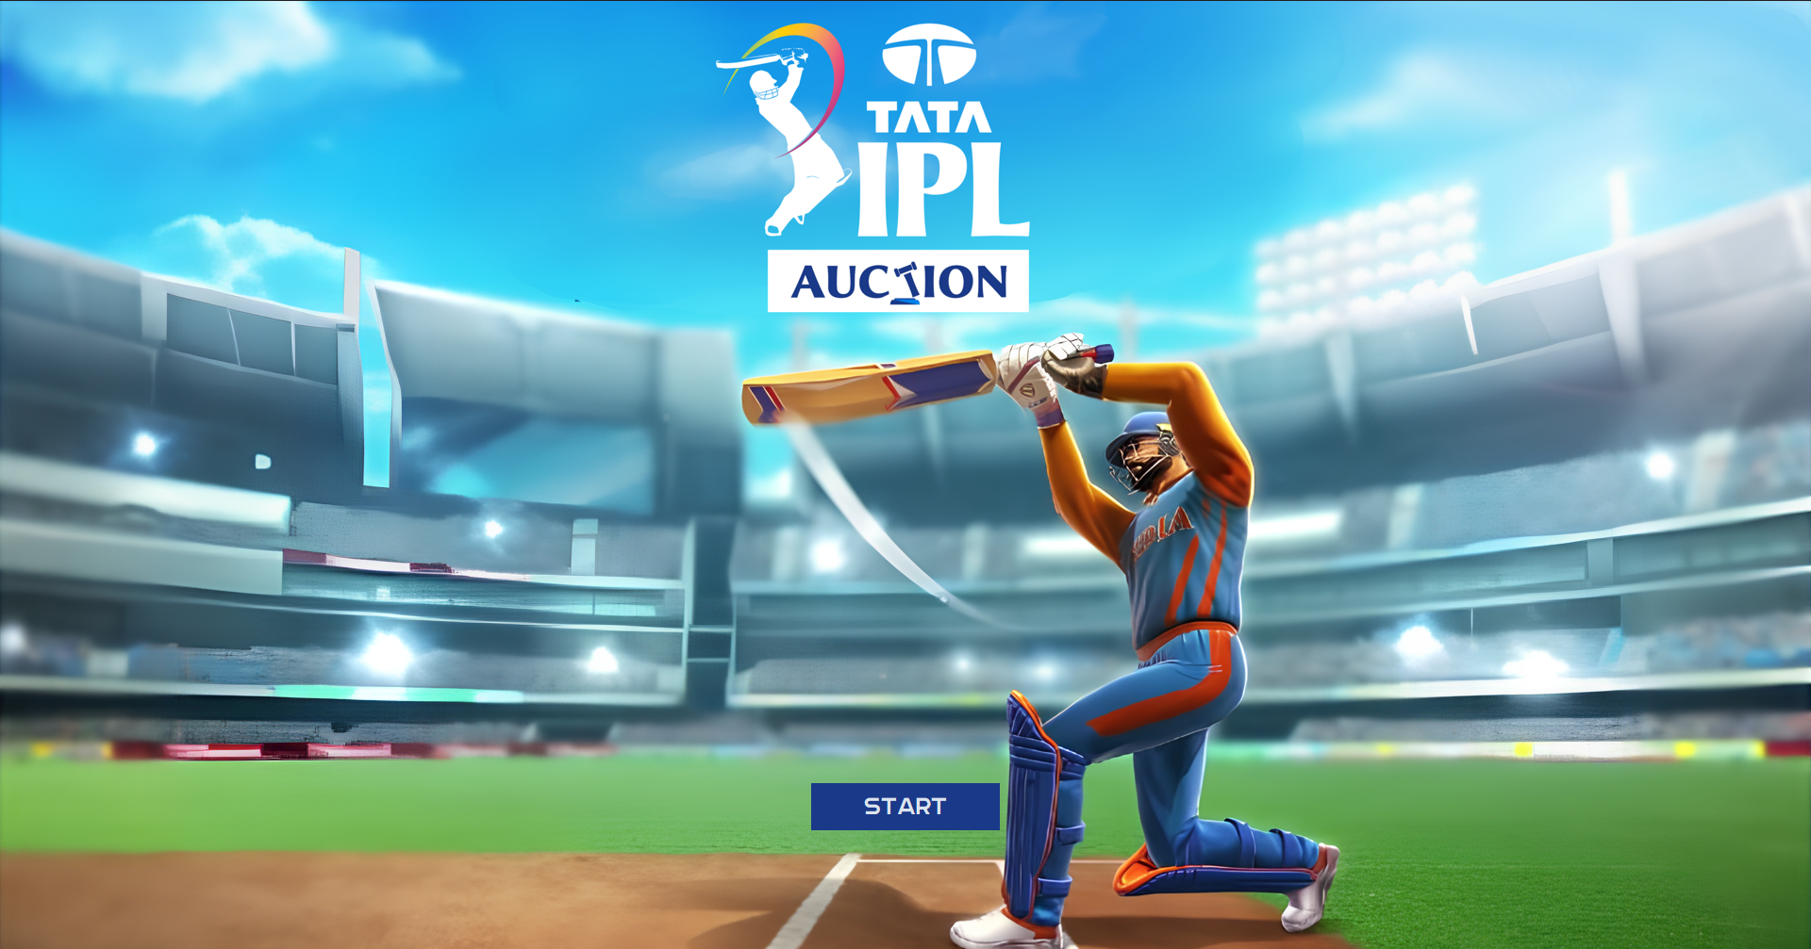
Python For Computational Problem Solving
UE23CS151A
MINI PROJECT
SEMESTER-1
“IPL AUCTION SIMULATOR

Slide 2
01
Sumit Nair
PES1UG23AM324
02
Sourish Joshi
PES1UG23EE051
Final Teams Page and PPT
Team Members and their roles
Tanmay Sankolli
PES1UG23EC323
Choose Teams Page and PPT
03
04
Swabhav D
PES1UG23EC316
Database

Slide 3

Problem Statement
Create a python project to simulate an IPL Auction. Use a list of players as a database and allow the user to introduce upto 15 players into their chosen team by bidding virtual money against 7 other teams (handled by bots) in the auction simulation

Slide 4
Learnings From The Project
We learnt to work with advanced functions in Python, while getting a lot of help from the community around the language with all the various resources like custom built modules, and guides. Working on this project also helped us understand working with databases in mySQL and also with designing a Graphical User Interface for our programs using tKinter. This will help us in our future projects with Python code and otherwise!

